Slide 1
Project Fake Taxi
Colin Bossuyt, Xander Vyvey, Alberiek Depreytere and Esteban Desmedt
https://github.com/vives-project-xp/Fake-Taxi
Notes:
Esteban

Slide 2
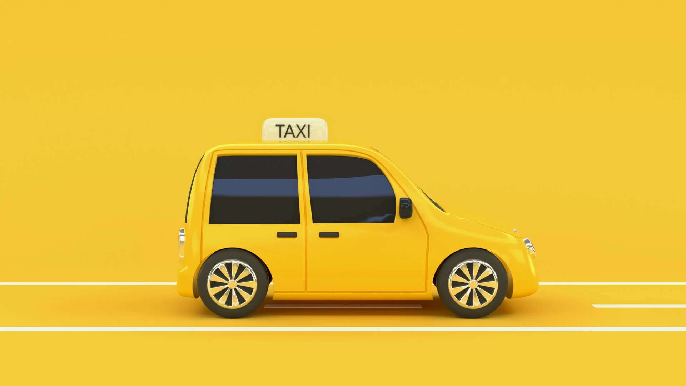
Table of contents
The role of each team member
The problem statement
The proof of concept
Code
The prototype of the product
The planning
Some final thoughts on the project
Notes:
Esteban

Slide 3
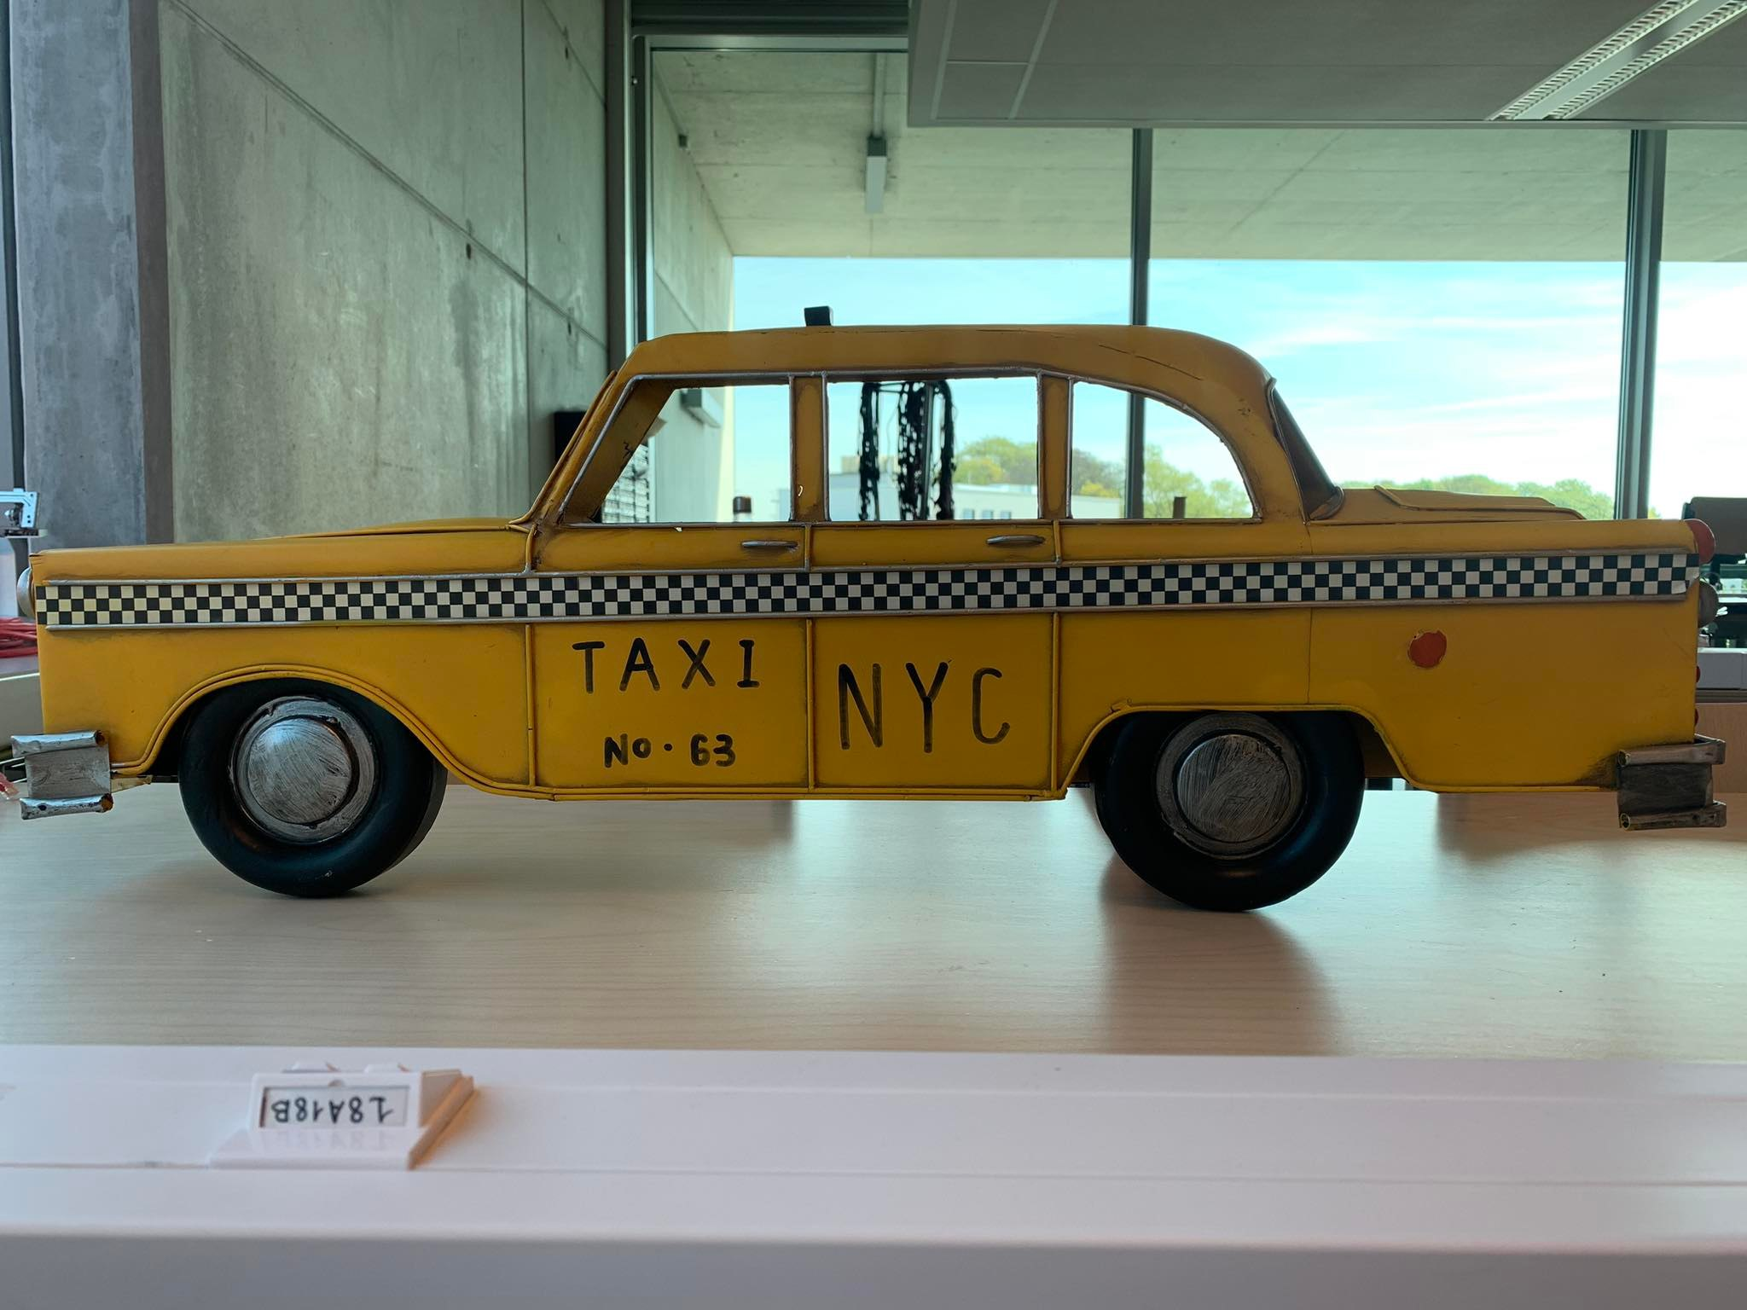
Meet our team
Notes:
Esteban

Slide 4
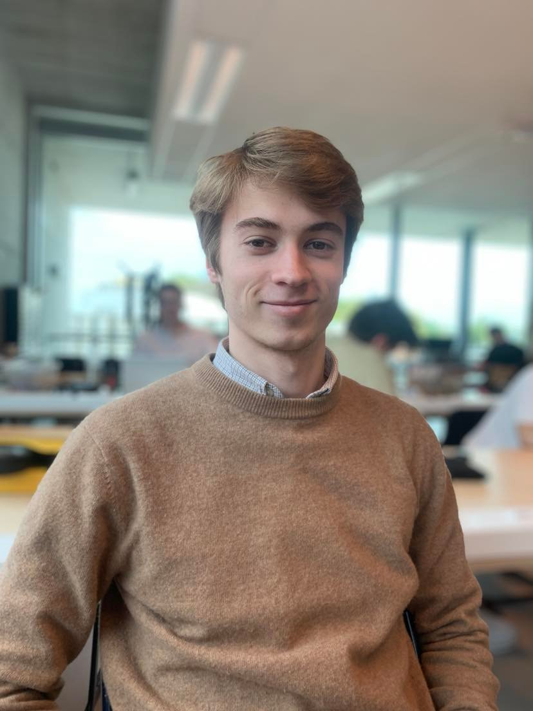
Colin Bossuyt
3D prints
Engine drive
G-code
Arduino IDE
Notes:
Colin

Slide 5
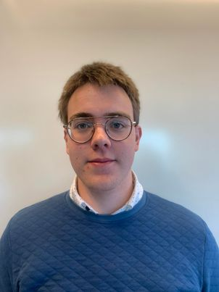
Alberiek Depreytere
Speaker
Elektronica
Notes:
Aleberiek

Slide 6
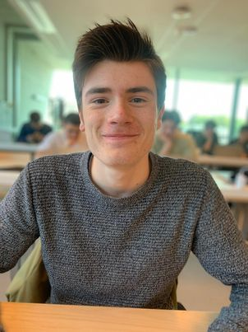
Xander Vyvey
Mechanica
Engine drive
ReadME
Prototype
Notes:
Xander

Slide 7
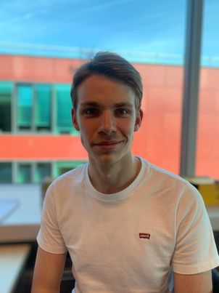
Esteban Desmedt
Software
Engine drive
Documentation
Video
Notes:
Esteban

Slide 8



Problem
Notes:
Xander

Slide 9
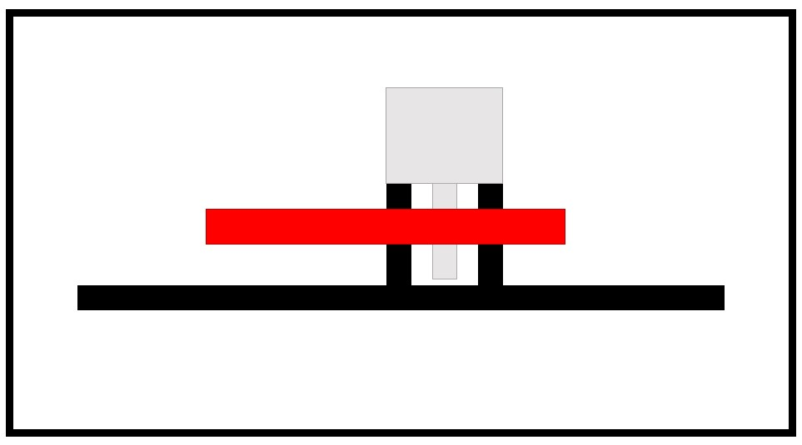
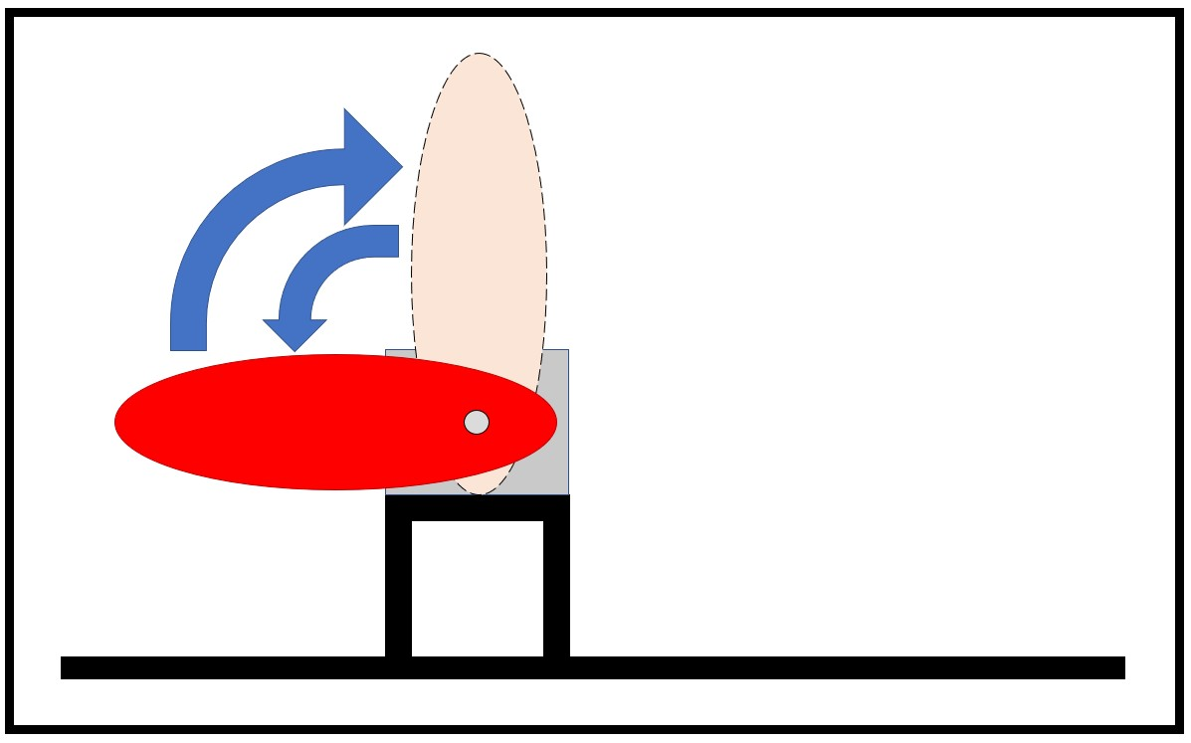
Concept
Notes:
Esteban

Slide 10
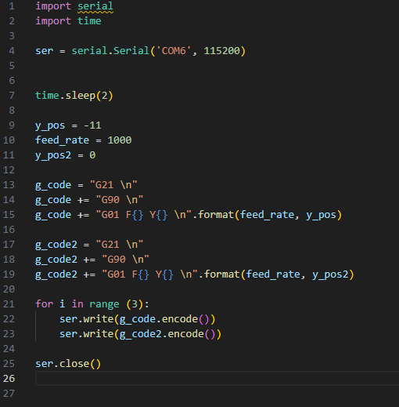
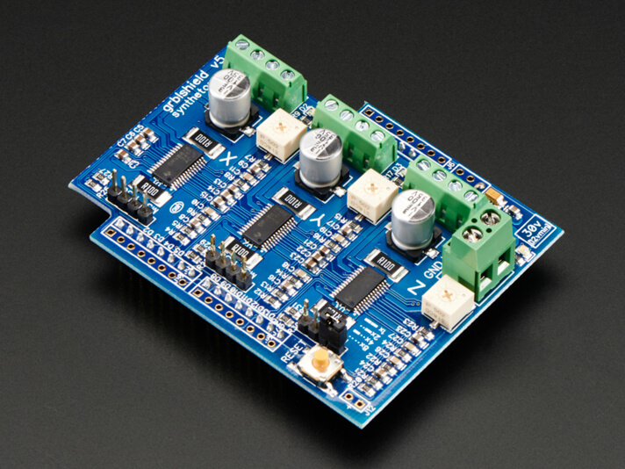
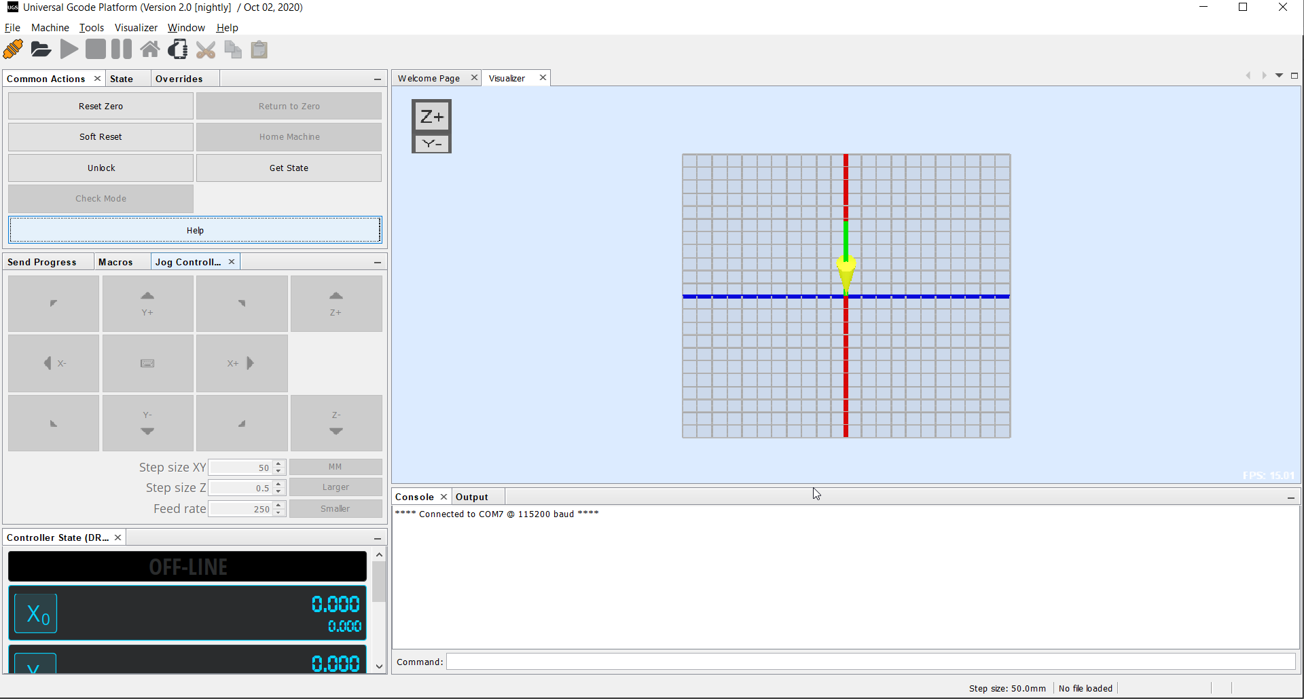
Code
Notes:
Colin

Slide 11
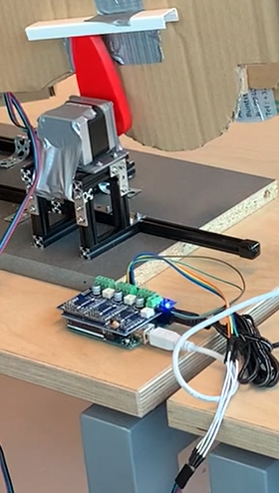
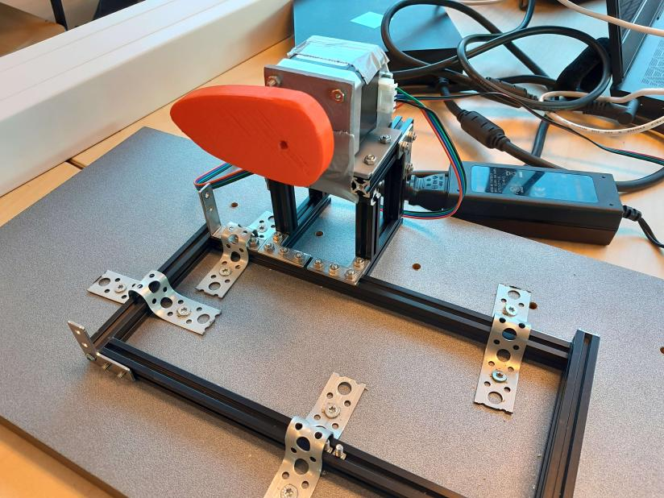
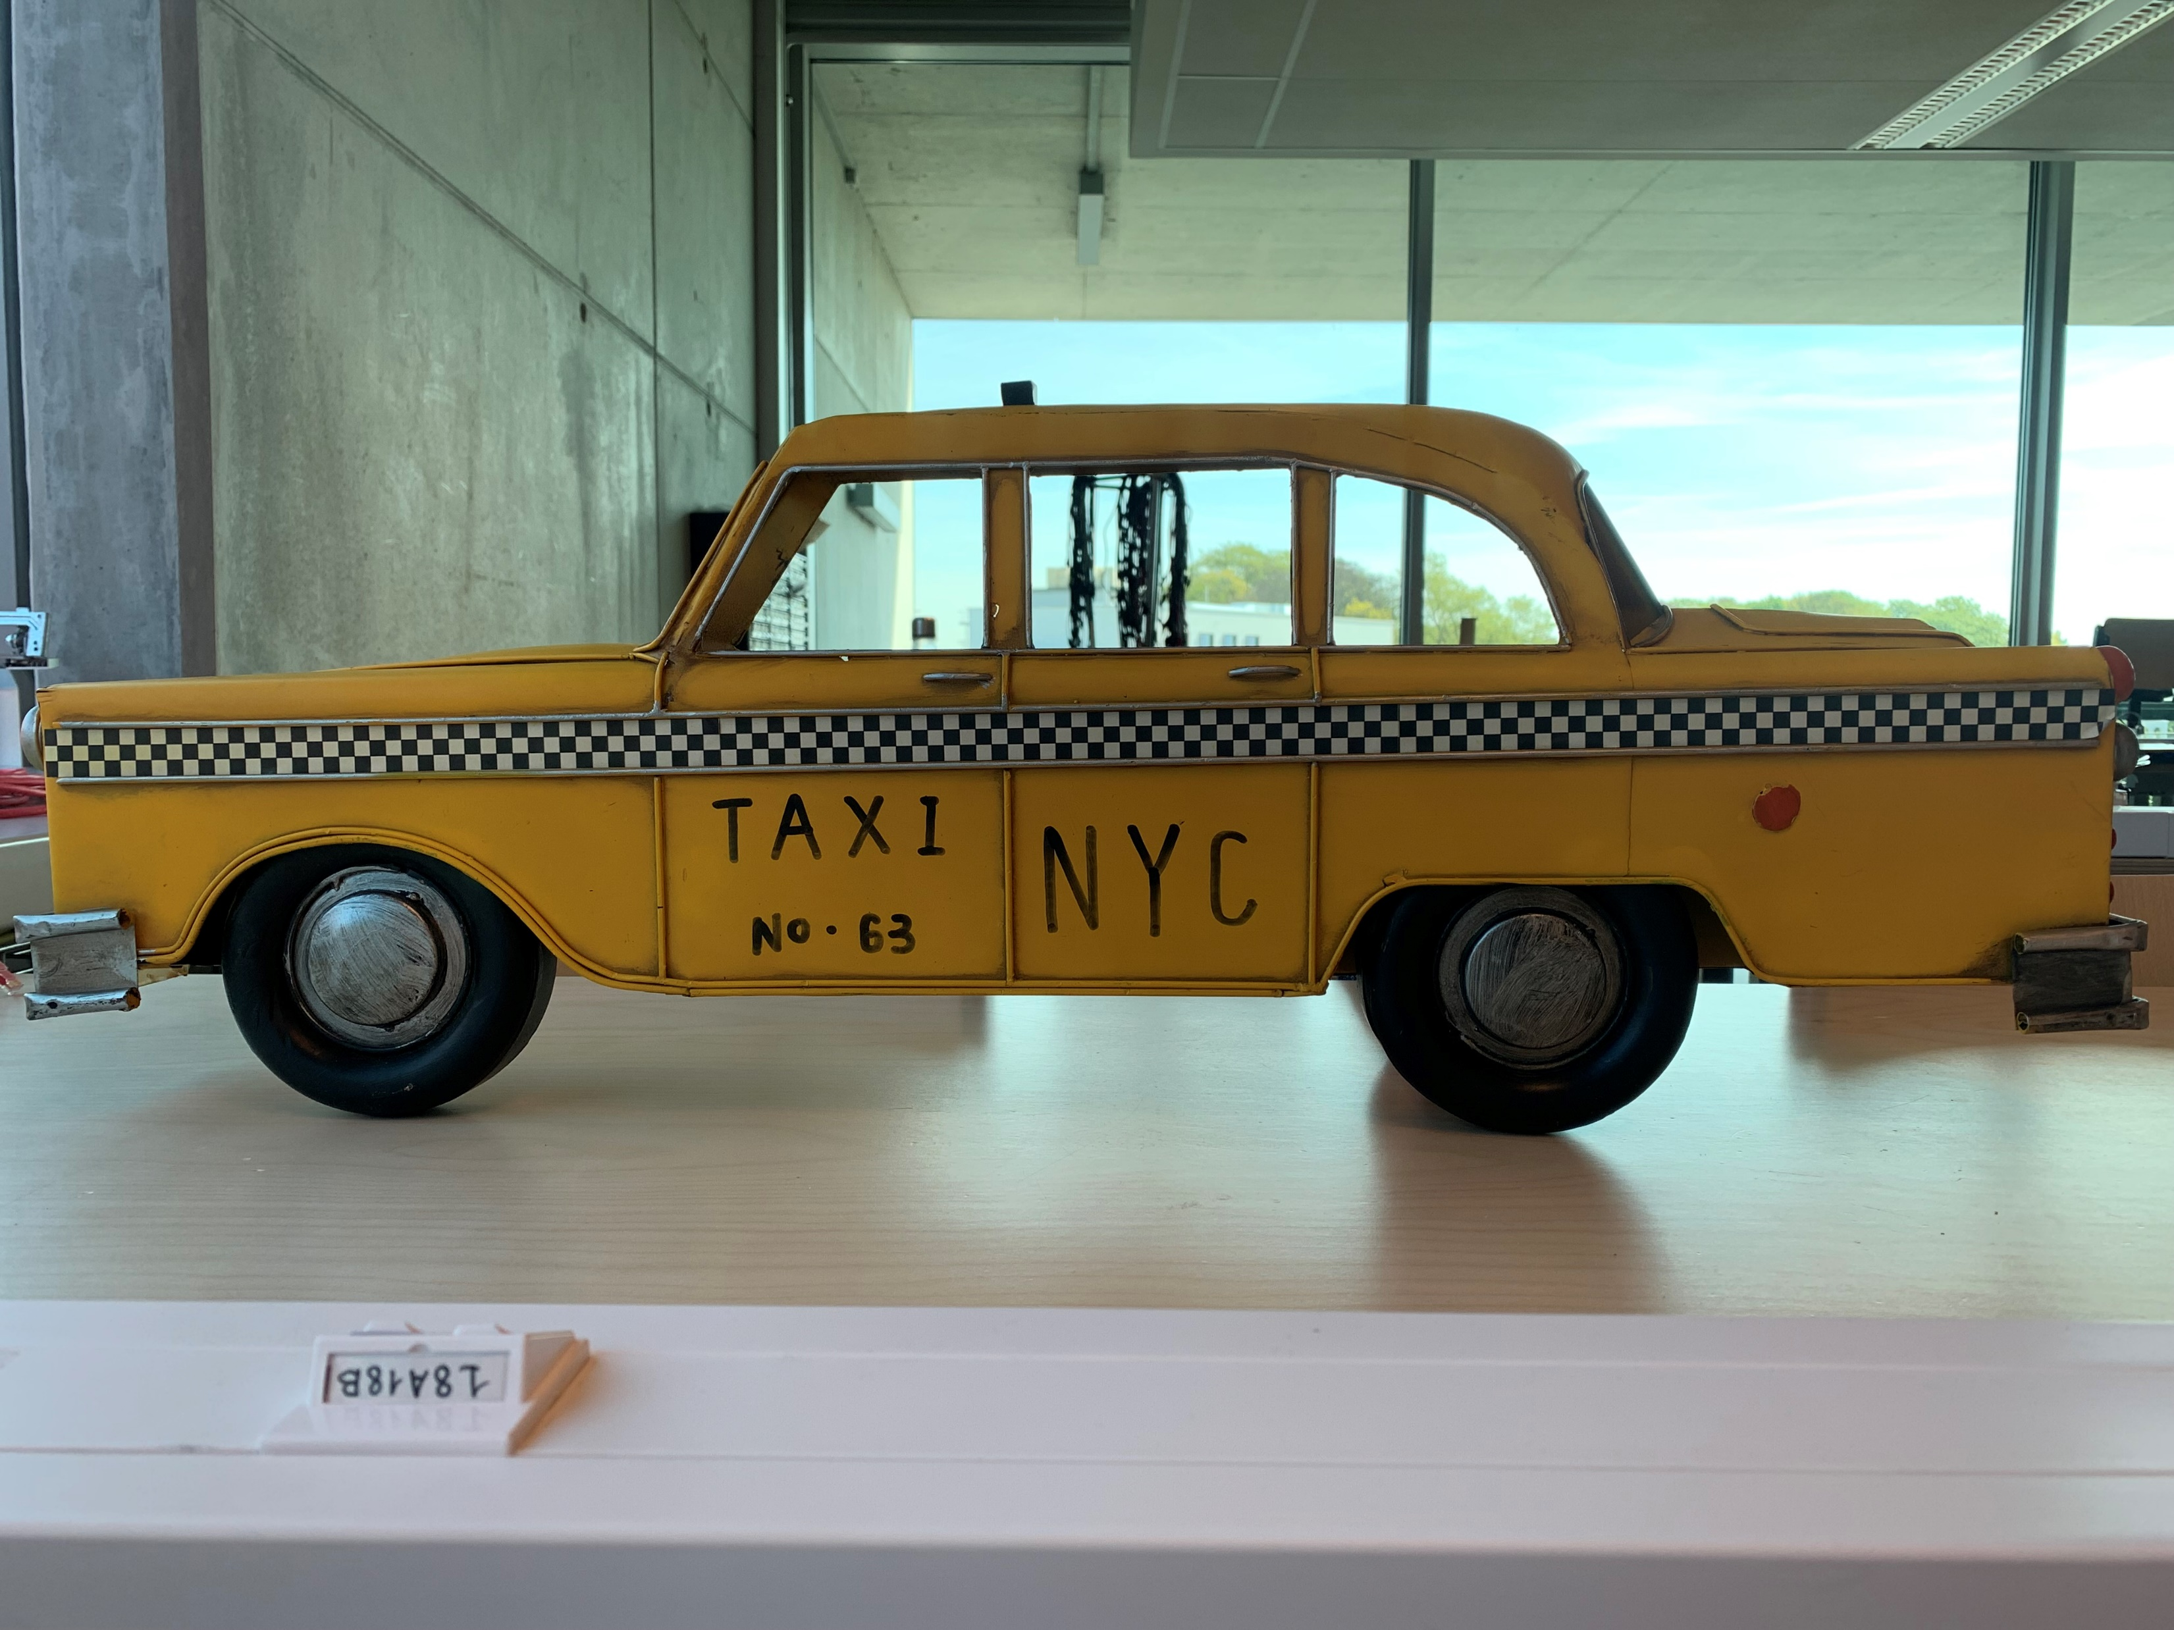
Prototype

Slide 12
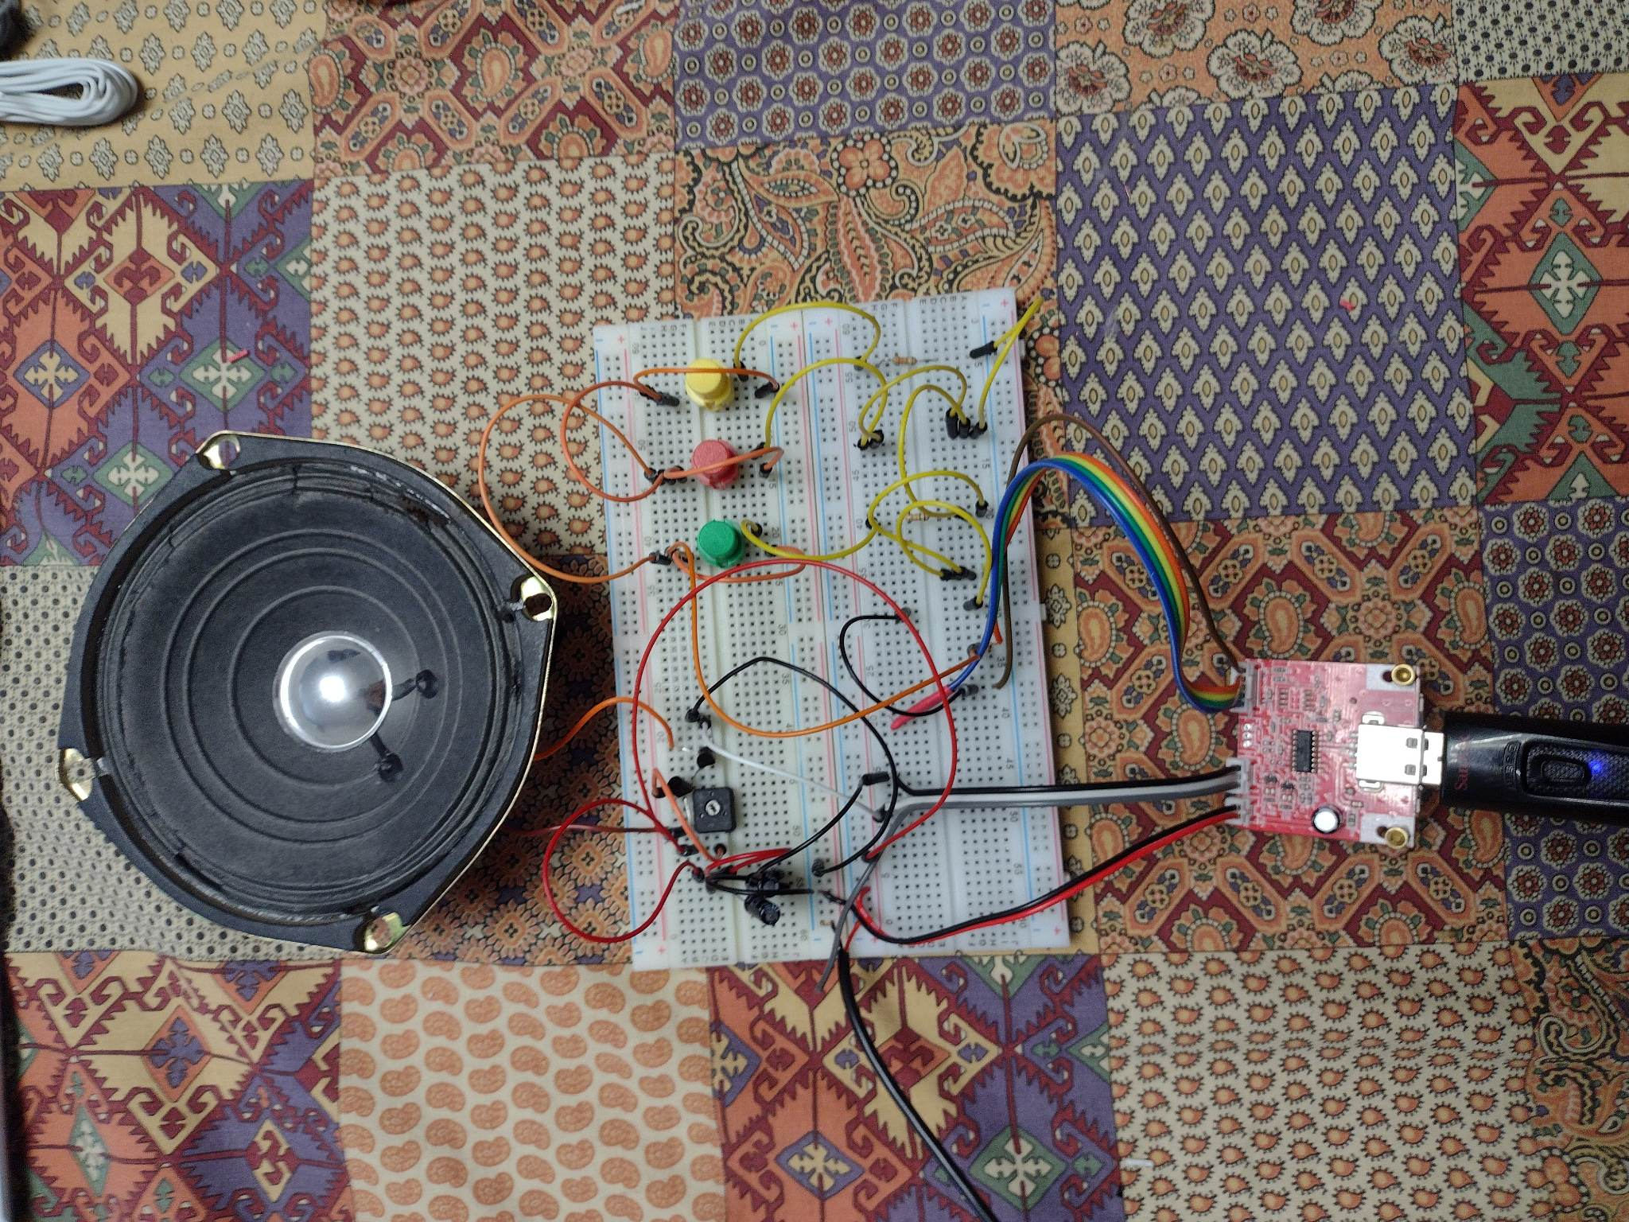
Prototype
Notes:
Alberiek

Slide 13
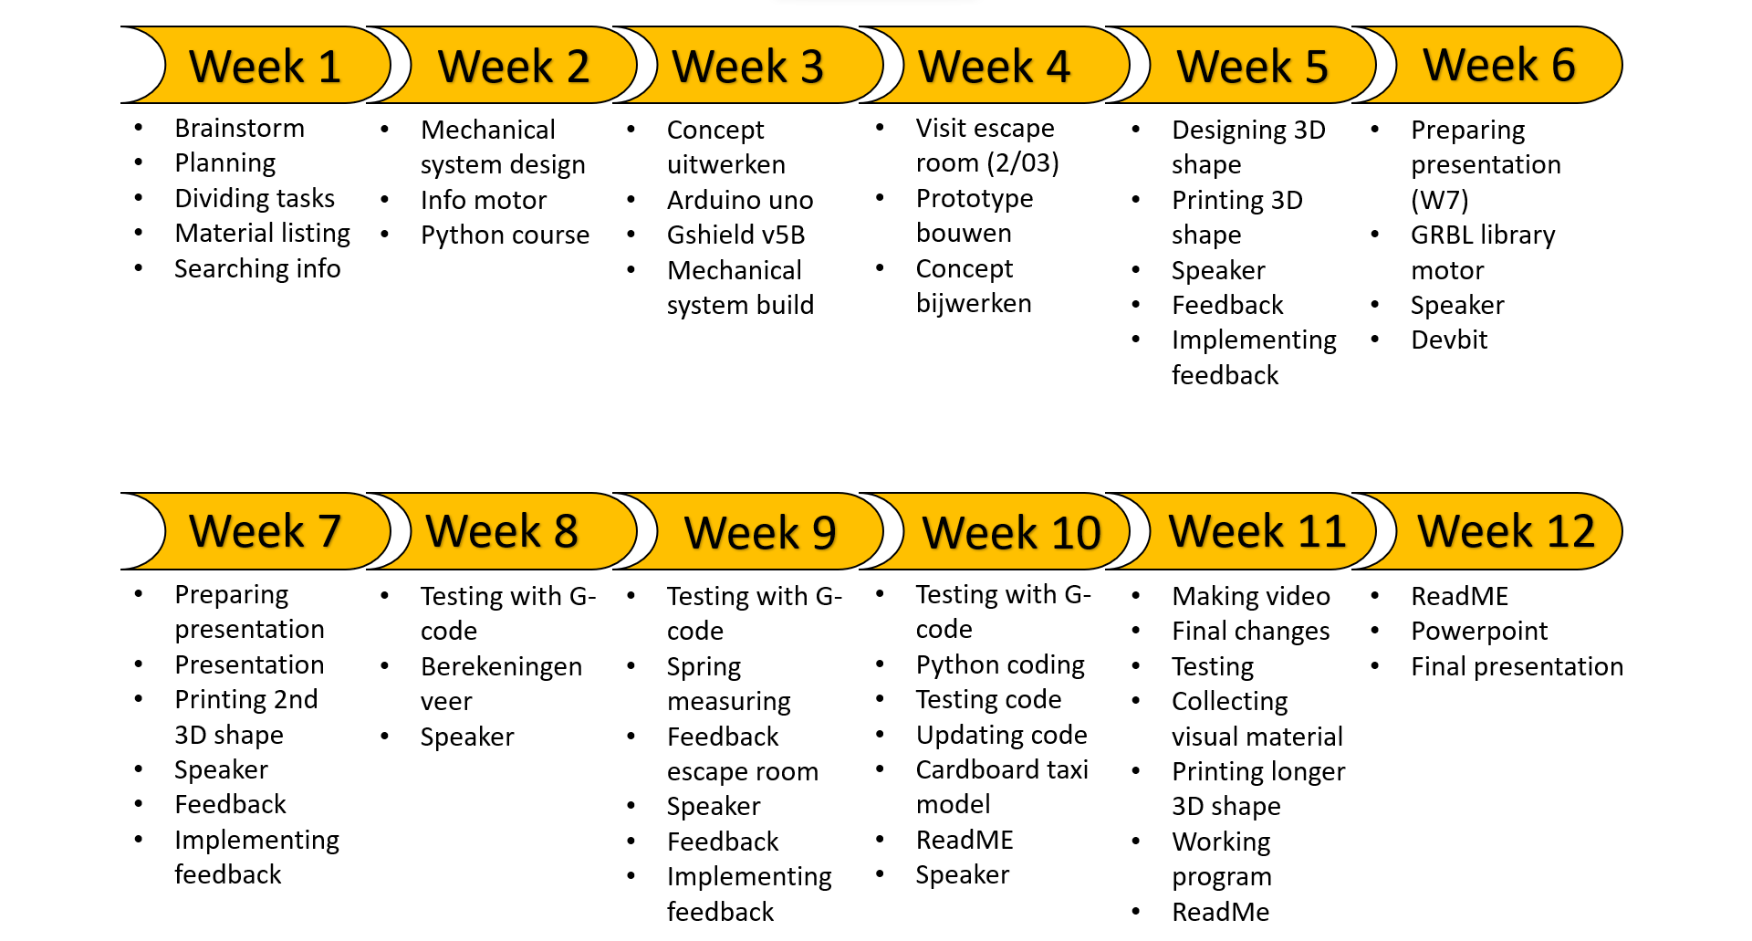
Planning
Notes:
Alberiek

Slide 14
Final thought?
Notes:
Colin

